Slide 1
Ortho Eyes
Raphael Pickl, Brice Lang-Nguyen,
Eddie Versluis, Hassan Ali, Arjun Sardjoe Missier, Lennart van Koppen, Rachelle Kiepe, Dr. Tony Andrioli
Notes:
Rachelle

Slide 2

Introduction
Laboratorium for Kinematics en Neuromechanics (LK&N)
Improving treatment and diagnosis of musculoskeletal system issues
Our research is focused on shoulder issues
Notes:
Rachelle

Slide 3
From Goniometer to Xbox-Kinect
Notes:
Rachelle
Where we come from, where we want to end up in the future

Slide 4
History of the project
First iteration (2017)
Research with kinect
Second iteration (2018)
Flock of birds – logistic regression
Third iteration (2019)
Flock of birds – unsupervised learning
To what extend and in what way, can different unsupervised data science techniques be used on kinematic recordings to contribute to a more valid and more reliable diagnosis, made by a doctor, on shoulder disability.
Notes:
Rachelle

Slide 5
State of the Project
We’re training Logistic Regression Model and a Recurrent Neural Network.
In order to accomplish that, we need to:
Get the best possible data from the LUMC
Clean our data
Enrich our data
Notes:
Rachelle

Slide 6
State of the Project
We’re training Logistic Regression Model and a Recurrent Neural Network.
In order to accomplish that, we need to:
Get the best possible data from the LUMC
Clean our data
Enrich our data
Notes:
Rachelle

Slide 7
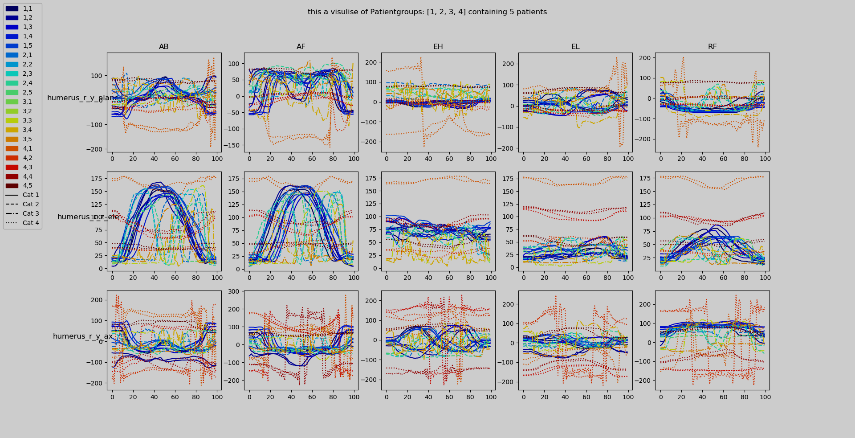
Patientgroup 4
Notes:
Rachelle

Slide 8
Patientgroup (PG) 4
PG 4 had different amount of data and no labels at first
We recieved RAW-files -> more data in PG 4 and labels
New PG 4 has completly different values than the PG’s
Still working on a fix with the LUMC
Notes:
Rachelle

Slide 9
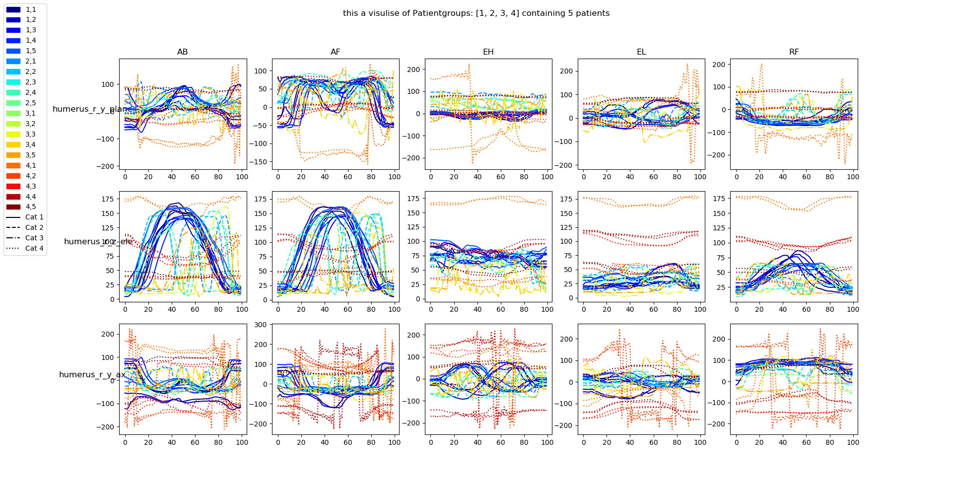
Notes:
Rachelle

Slide 10
Data Cleaning
Notes:
Raphi
80% what datascientists do: Datacleaning
Most important but tedious

Slide 11
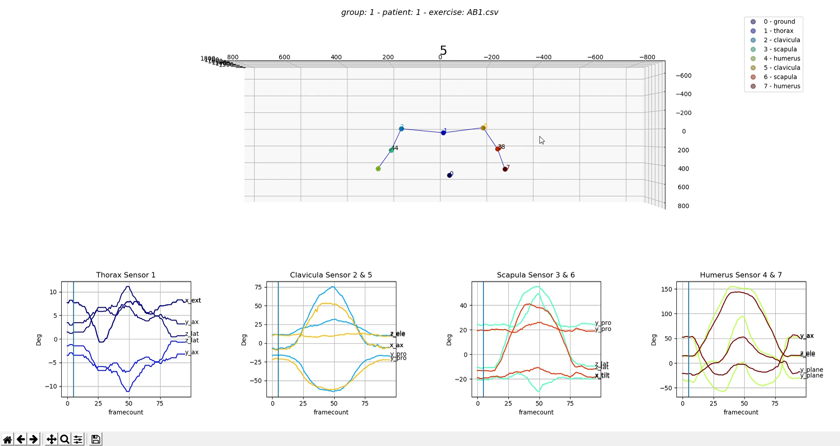
How we see
the data
Notes:
Raphi
To clean the data one have to understand
Raw visualization and the converted files
Gimballock was in the way of more beautiful vizualizations

Slide 12
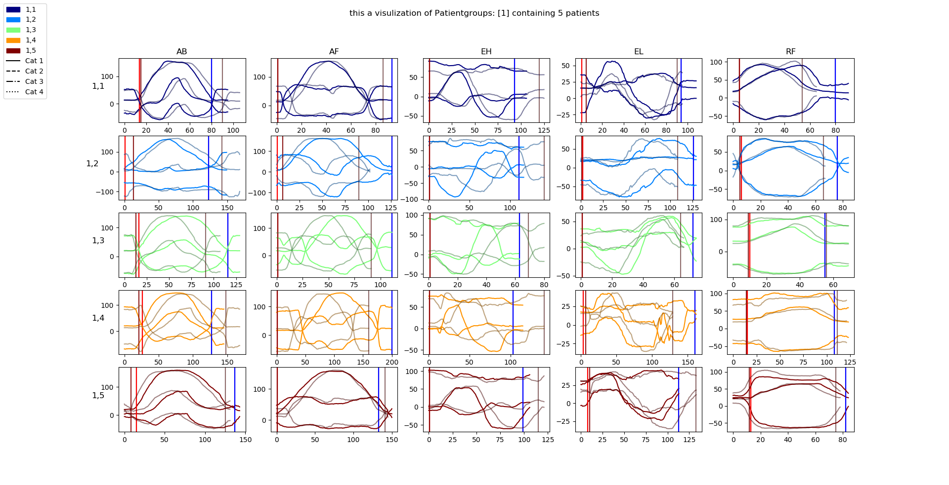
Removing the idle
Notes:
Raphi
Two exercises per patient -> different colors
Graph shows rotation over time.
We chose axes (the bone) with the most difference in movement and from there we calculated the change in movement over time.
If the change is big, the exercise start. Same backwards

Slide 13
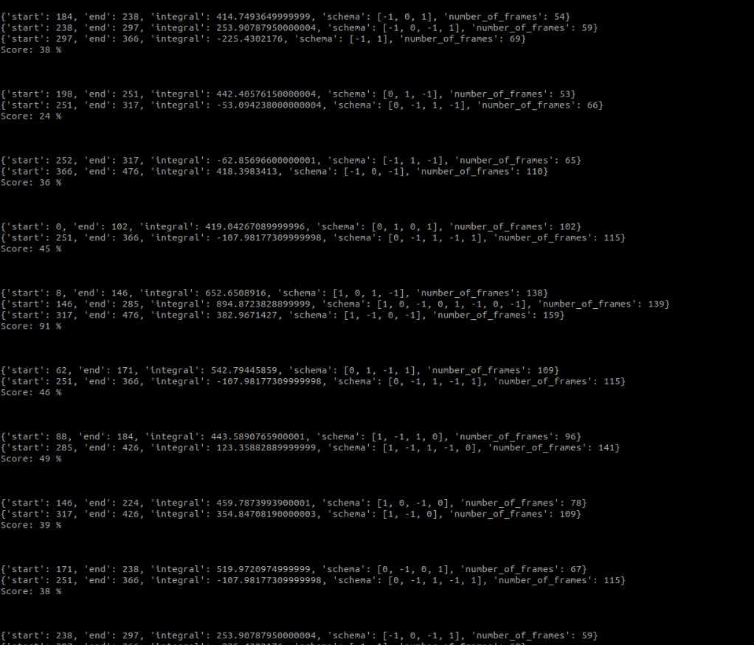
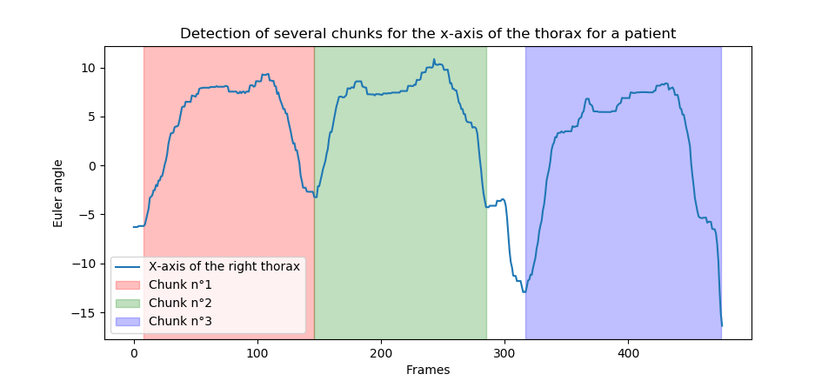
Work in Progress
Detect “double exercises”
Detect wrongly named exercises
Notes:
Raphi
We’re working on a new description of the data using 2D vectors.
With this description we can find out If there are 2 times the same exercise in one file.

Slide 14
Data Enrichment
Notes:
Raphi
Problem with time, this leads to a couple of different enrichment methods.

Slide 15
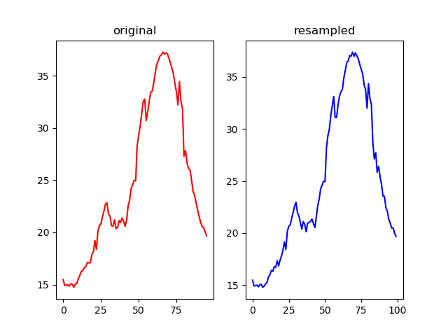
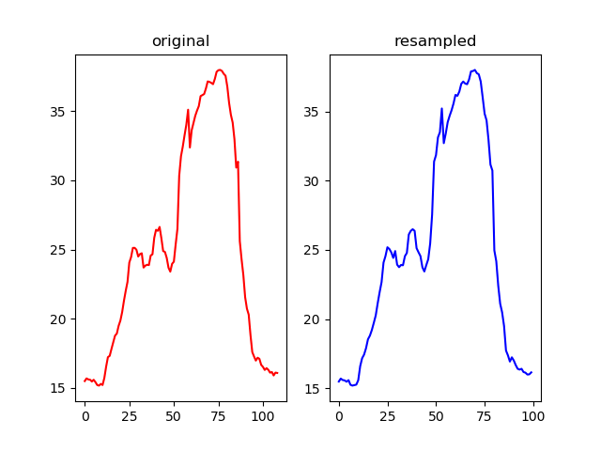
Resample exercises
Notes:
Raphi
Biggest problem, difference in time, therefore we’ve written a script to resample the exercises.
We can now resample all the exercises to a length we would like, only using mathematics
Often it smoothes out the data, sometime sudden changes overreact

Slide 16
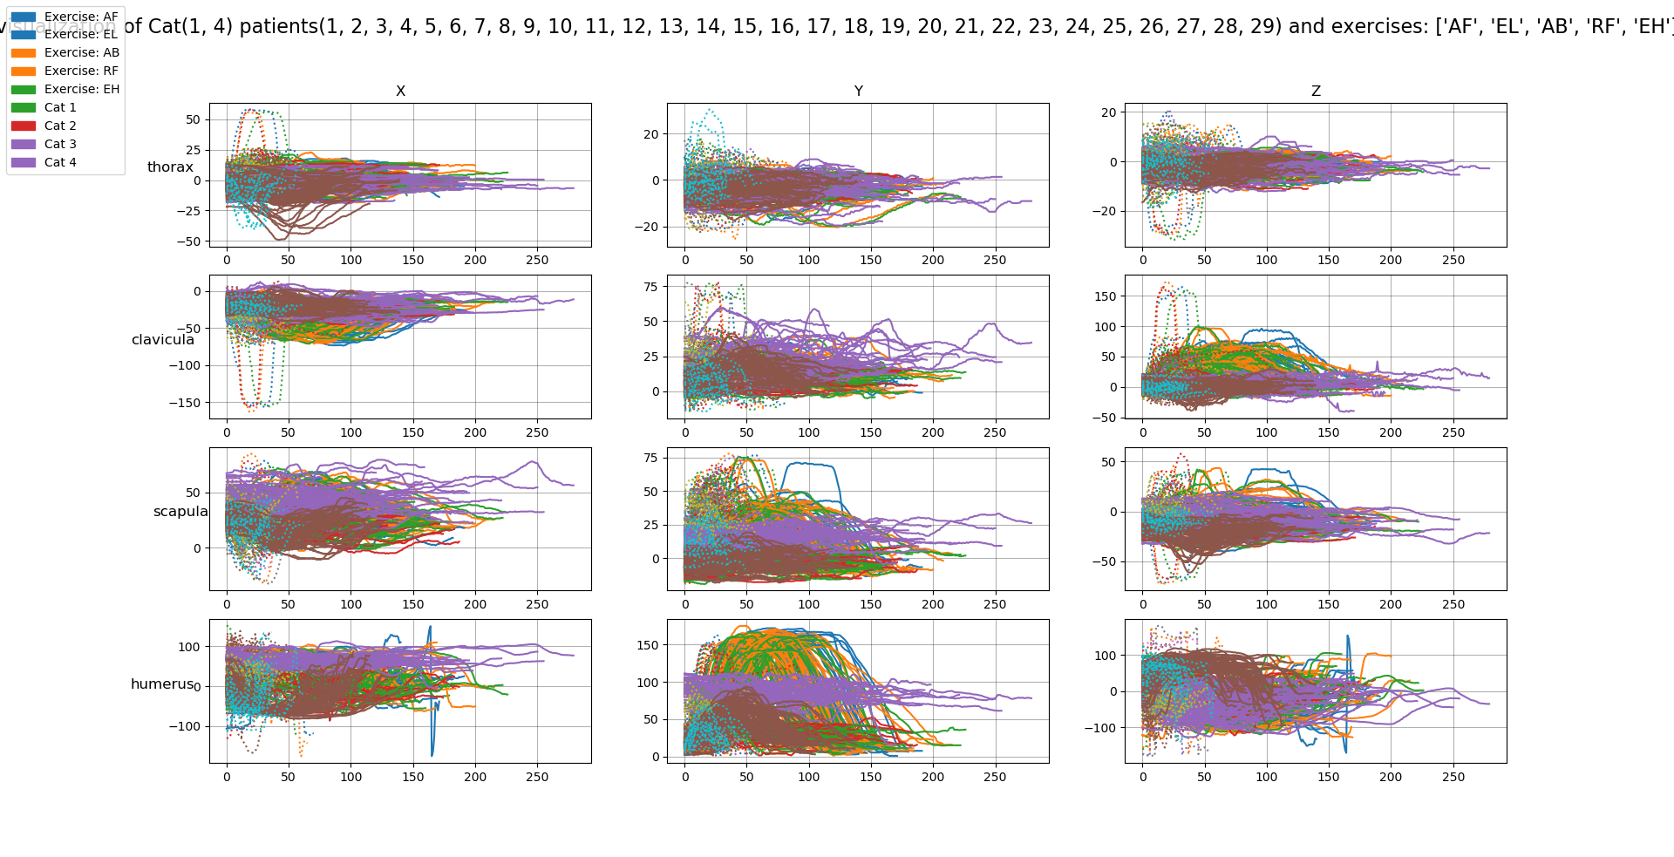
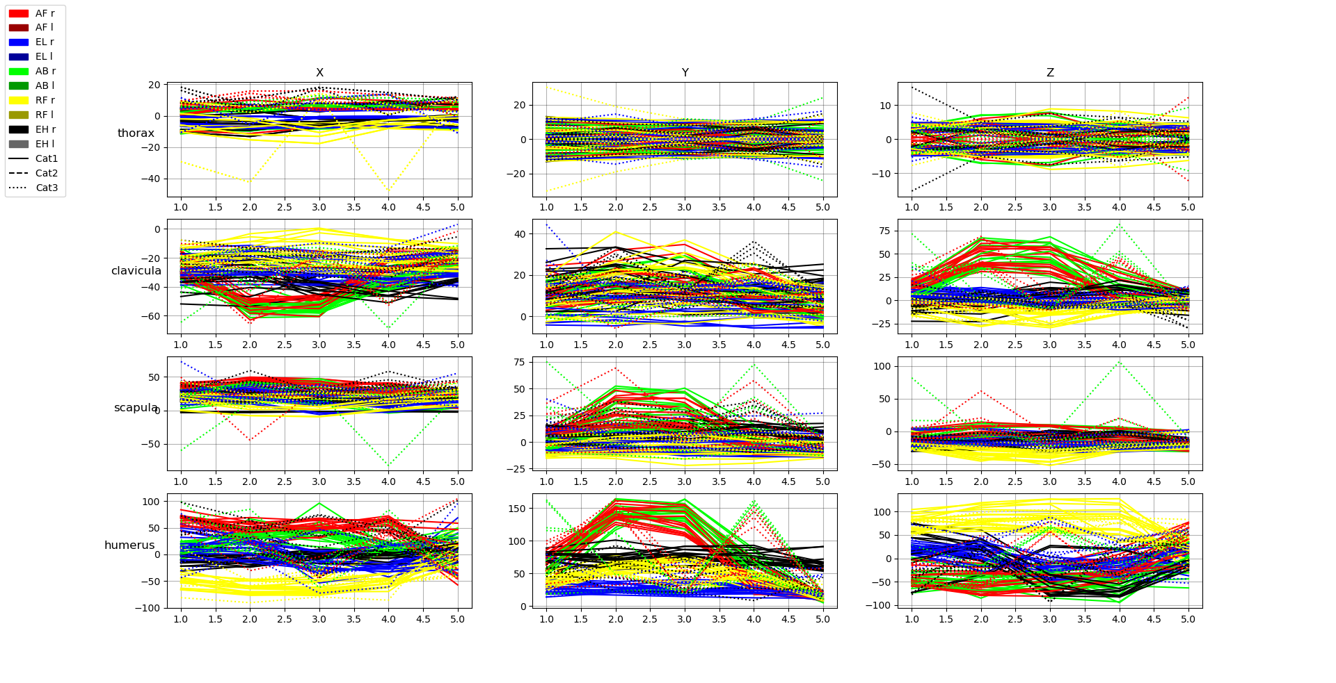
Frame Generator
For framecount = 100
20, 45, 70, 95
21, 46, 71, 96
22, 47, 72, 97
Notes:
Raphi

Slide 17
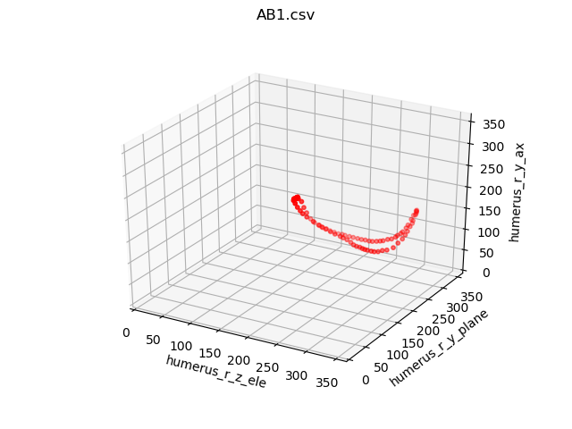
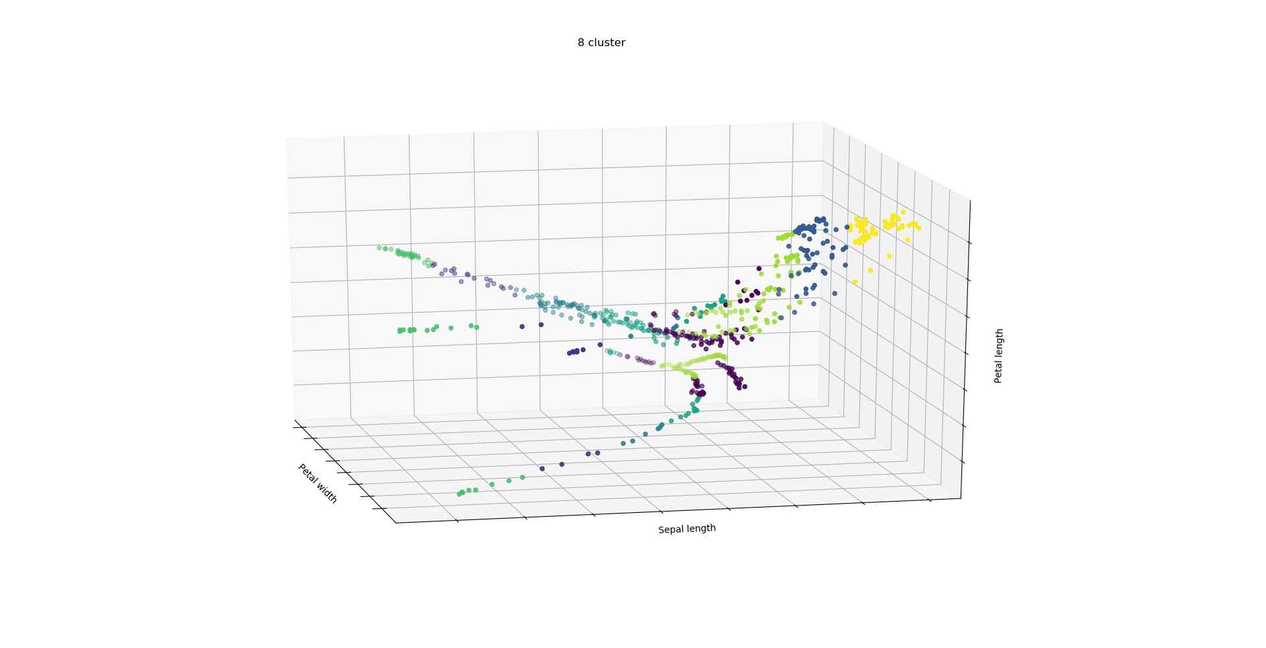
Space description
Notes:
Raphi

Slide 18
What now?
Fix everything that is still wrong with Patientgroup 4
Finalize script to remove “double exercises”
Train a Recurrent Neural Network using timeseries
Combine data enrichment and cleaning techniques in an automated script to train the best possible model
Notes:
Raphi

Slide 19
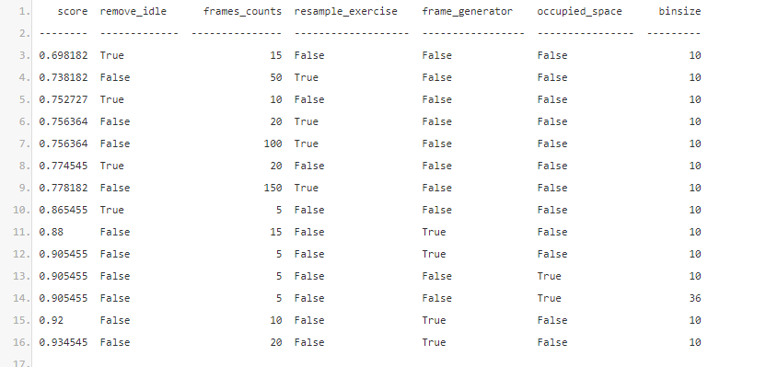
Different Models on PG 1-3

Slide 20
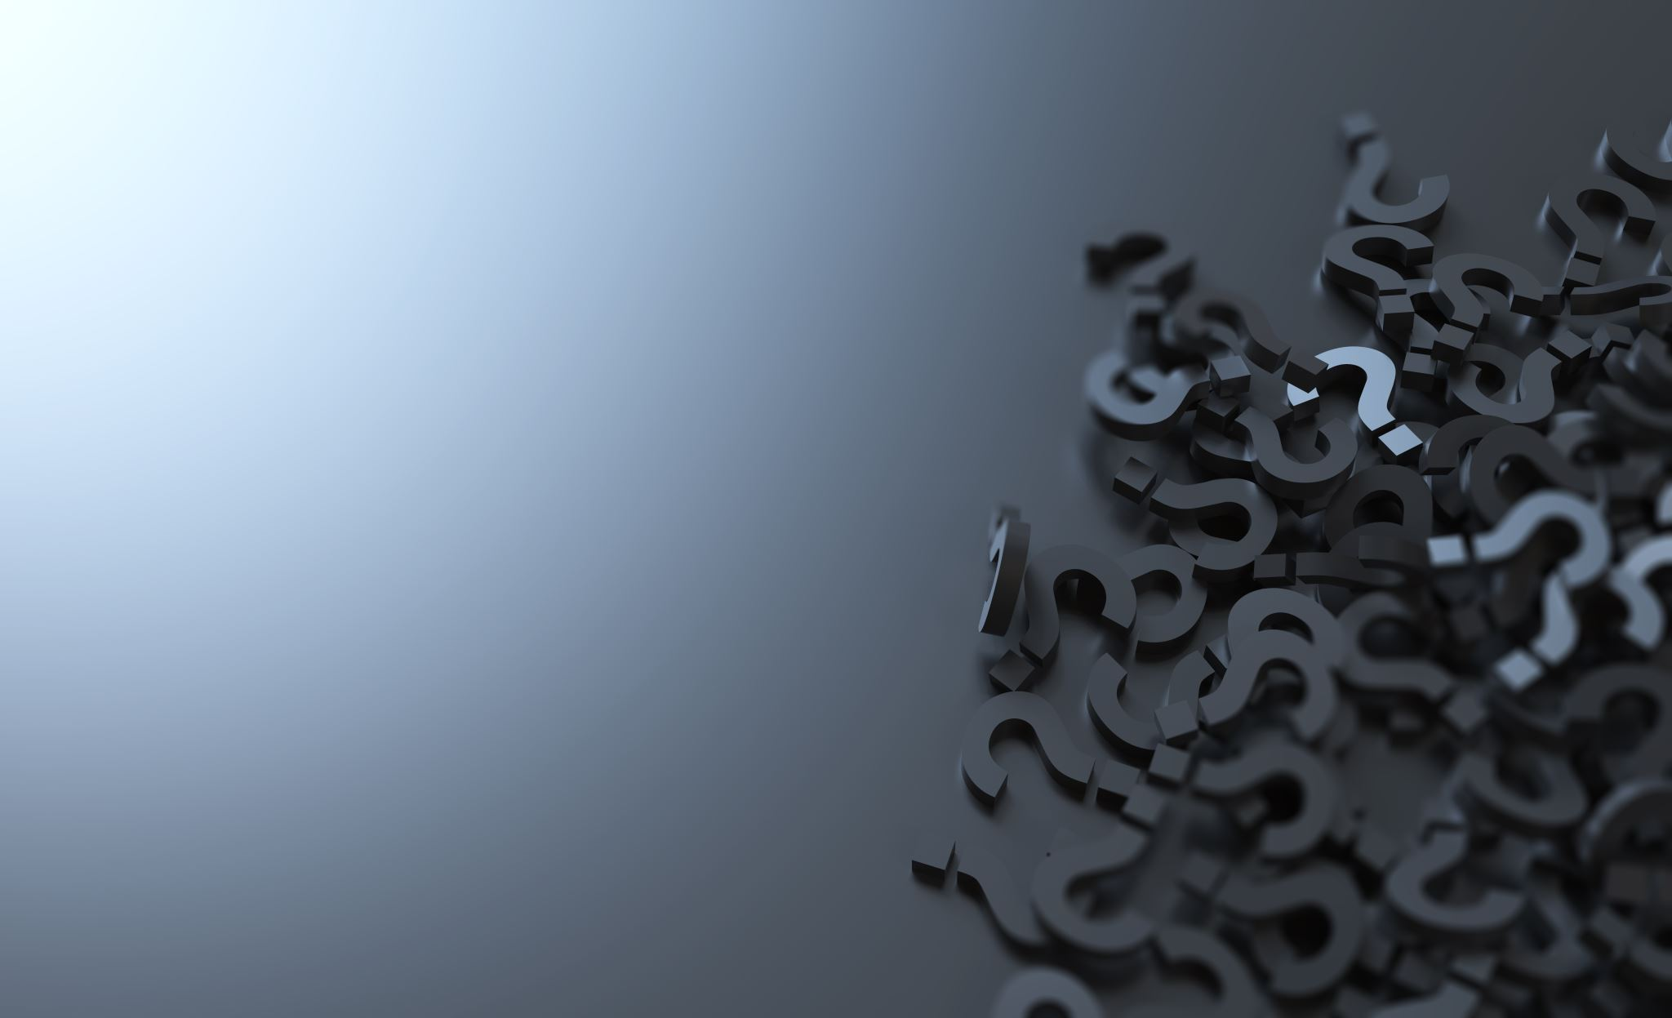
Questions?
Thank you for listening!
Notes:
Raphi

